Slide 1
Hall Management System

Slide 2
Outline
Entity Relationship Diagram
ERD in depth Analysis
Database Schema
Trigger
Procedure
View
Role

Slide 3
Entity Relationship Diagram

Slide 4
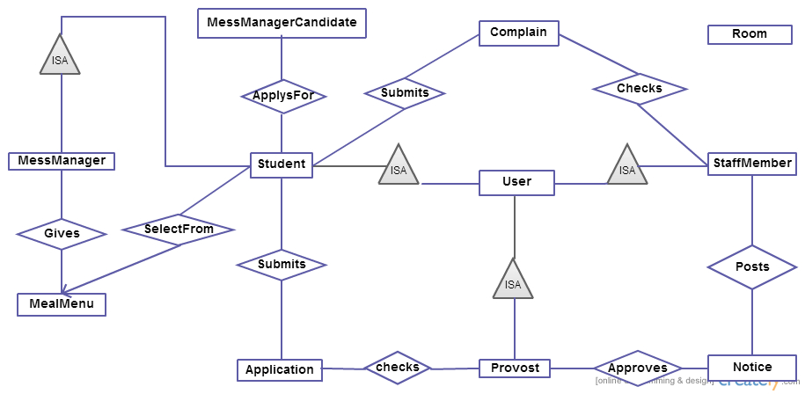
Figure : Entity Relationship Diagram

Slide 5
ERD in depth Analysis

Slide 6
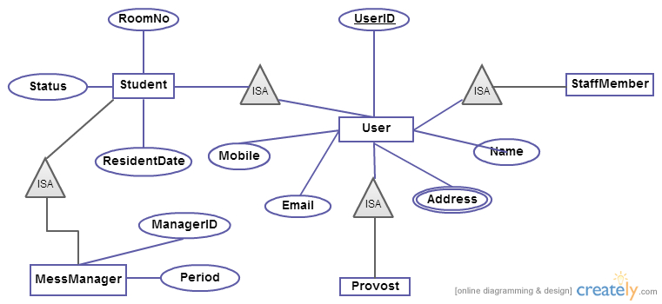
Figure : Entity Relationship Diagram

Slide 7
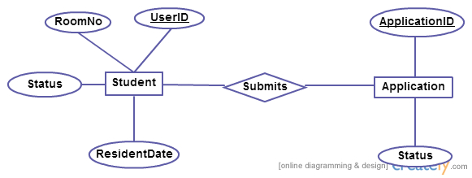
Figure : Entity Relationship Diagram

Slide 8
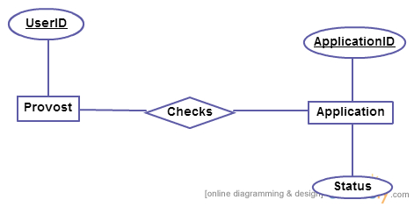
Figure : Entity Relationship Diagram

Slide 9
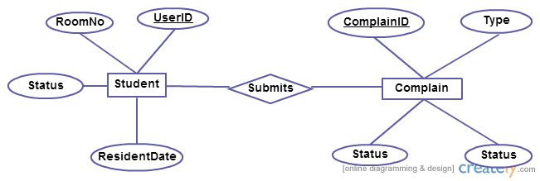
Figure : Entity Relationship Diagram

Slide 10
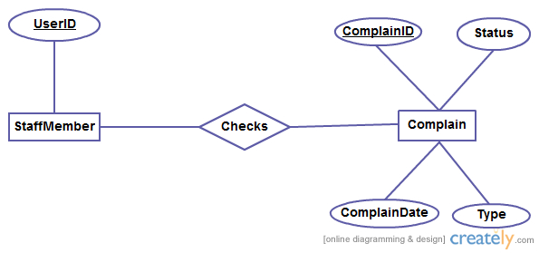
Figure : Entity Relationship Diagram

Slide 11
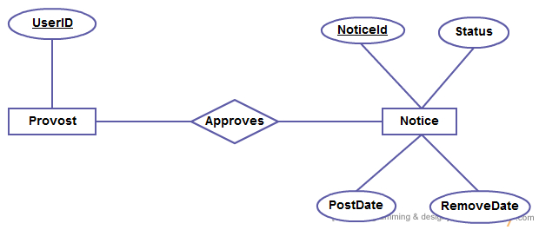
Figure : Entity Relationship Diagram

Slide 12
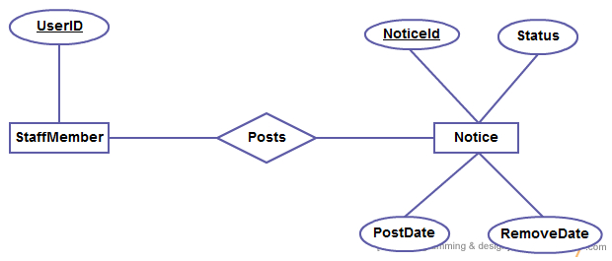
Figure : Entity Relationship Diagram

Slide 13
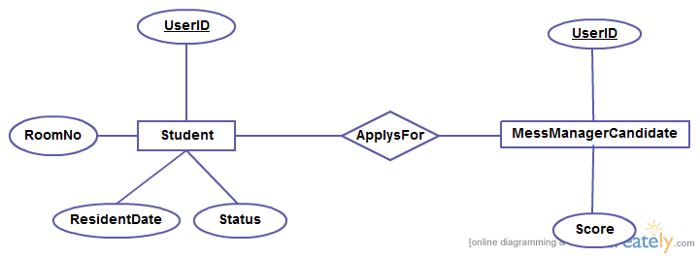
Figure : Entity Relationship Diagram

Slide 14
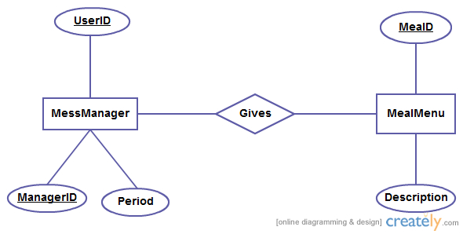
Figure : Entity Relationship Diagram

Slide 15
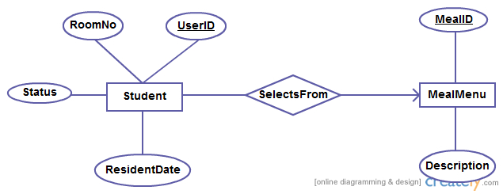
Figure : Entity Relationship Diagram

Slide 16
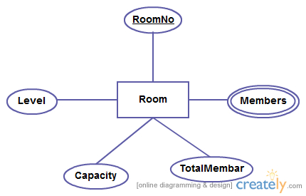
Figure : Entity Relationship Diagram

Slide 17
Database Schema

Slide 18
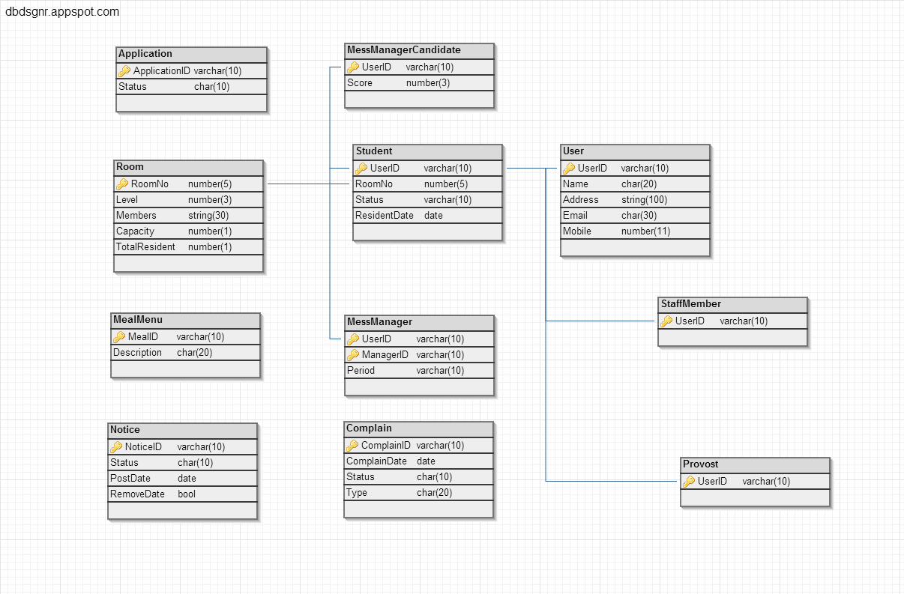
Figure : Database Schema for Hall Management System

Slide 19
Trigger

Slide 20
Trigger 1
Trigger Name: defaultMealSelection
  Time of Execution: After Meal selection timeLimit ends and isMealSelected sets to NO.
  Actions:
    Commands: SelectDefault
    Attributes: MealID
    Tables: Meal
    Remarks: To prevent issues when no meal is selected by a student.

Slide 21
Trigger 2
Trigger Name: startVoteCount
  Time of Execution: After isVotingFinished sets to YES
  Actions:
    Commands: Count
    Attributes: studentID
    Tables: Mess Manager
    Remarks: To process result count when voting is done.

Slide 22
Trigger 3
Trigger Name: deleteExpiredNotice
  Time of Execution: After noticeStatus sets to EXPIRED
  Actions:
    Commands: delete
    Attributes: NoticeID
    Tables: Notice
    Remarks: helps maintenance easy and up to date with most important notices.

Slide 23
Trigger 4
Trigger Name: makeStudentResident
  Time of Execution: After isApproved sets to YES
  Actions:
    Commands: makeResident
    Attributes: StudentID
    Tables: Student
    Remarks: Autoupdate resident status after being approved by provost.

Slide 24
Procedure

Slide 25
Procedure(1)
Procedure Name | getResidentStudentList
Time of Execution | Provost has to submit monthly a resident list to the administration office
Input | Nil
Output | List of names of resident students and the date of their being resident
Apply on | Student
Action | Remarks
Select name and date of being resident from Student | Select the name and resident date from table Student where status = ‘Resident’

Slide 26
Procedure(2)
Procedure Name | getMealList
Time of Execution | When the provost wants to see if any mess manager is managing meals okay
Input | Date1, Date2
Output | List of name of the meals that are served within Date1 and Date2
Apply on | Meal
Action | Remarks
Select meal from Meal where date of meal >= Date1 and =< Date2 | Select all the food meals from the table Meal and showed in a ascending order by date

Slide 27
Procedure(3)
Procedure Name | getRoomMaintenanceComplain
Time of Execution | Any time a student posts a complain that is under Room Maintenance it is immediately acknowledged
Input | Nil
Output | List of name room and the problem description
Apply on | Complain
Action | Remarks
Select complain from Complain where type = ‘Room Maintenance’ | This type of problems are served immediately by the staff members

Slide 28
Procedure(4)
Procedure Name | getExpiredNotice
Time of Execution | Any time a student wants to see those notices that are old and expired
Input | Date1, Date2
Output | List of notice along with their publishing date
Apply on | Notice
Action | Remarks
Select notice from Notice where publishing date is >= Date1 and =< Date2 | Select all notice from Notice within Date1 and Date2 and showed in a ascending order by date

Slide 29
Procedure(5)
Procedure Name | getRecentResidentList
Time of Execution | When a provost wants to see the resident students that joined recently
Input | Date1
Output | List of recently resident students that joined after Date1
Apply on | Notice
Action | Remarks
Select name and student_ID from Student where date of being resident >= Date1 | Show the name and student_ID from Student in an ascending order of date

Slide 30
View

Slide 31
View 1
Election view: Here the students can see the selected candidate list for voting in the mess manager election.

Slide 32
View 2
Notice view:
Here students can see the published notice by the hall staff members.

Slide 33
View 3
Room view
Here the list of the rooms which are empty is supplied to the hall supervisor. After having the supplied list he can assign the eligible student an empty room.

Slide 34
Role

Slide 35
Role 1
create role provost_role;
grant all privileges on
Application
to provost_role;

Slide 36
Role 2
create role supervisor_role;
grant all privileges on
empty room
to supervisor_role;

